Slide 1
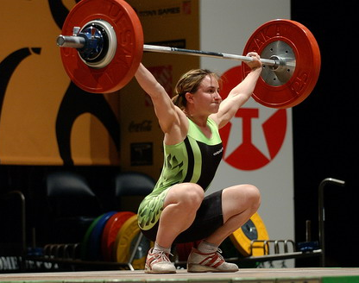
Efficiency and Power
This lesson will introduce you to the physics definition of power
You will also learn how to use the equations of power to solve
problems involving power, energy, and efficiency.

Slide 2
Learning Goals
By the end of this lesson, you will be able to:
define efficiency
define power
solve problems involving efficiency and power

Slide 3
Success Criteria
Can I:
state and explain what is meant by efficiency
state the definition of power
solve problems involving efficiency and power

Slide 4
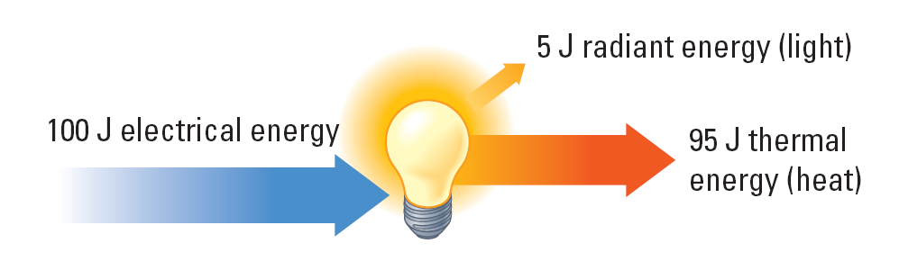
Efficiency
The efficiency of a device is the ratio of the useful energy output to the total energy input.

Slide 5
Sample Problem
A car engine produces a force of 2500 N to accelerate a car over a distance of 34 m? If it burns 4.25x10⁵ J of gasoline to do this, determine the efficiency of the engine.
Sol’n:
E_{out} = W
F = 2500 N
E_{in} = 4.25 x 10⁵ J
Δd = 34m
E_{out} = ?
eff =?

Slide 6
∴ the eff of the engine is 20.%

Slide 7
Power
Power, P, is defined as the rate at which work is done, or the rate at which energy is transformed
Power is a scalar quantity
The symbol for power is P
Power is measured in J/s or Watts, W
1 W = 1 J/s

Slide 9
Sample Problem
A weightlifter lifts a 155 kg barbell a vertical distance of 2.00 m in 1.25 s. What is her power generated?
Sol’n:
m = 155 kg
h_{i} = 0 m
h_{f} =2.00 m
Δt = 1.25 s
P = ?

Slide 10
∴ the power is 2430 W

Slide 11
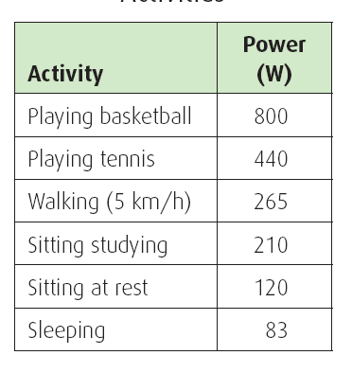
Energy Consumption

Slide 12
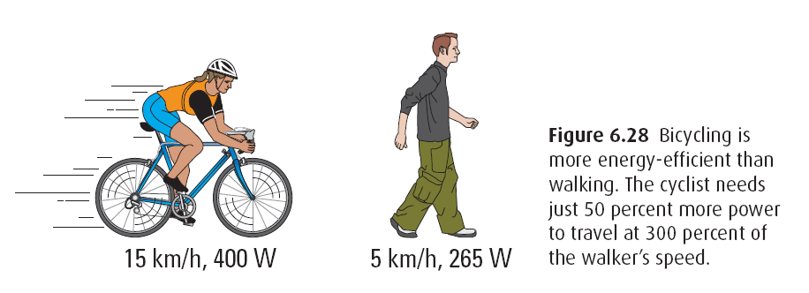
Another unit of energy is the kilowatt hour, kW∙h
1 kW∙h = 3.6 x 10⁶ J

Slide 13
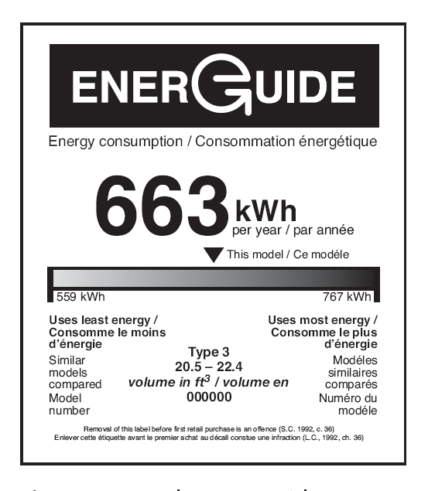

Slide 14
HOMEWORK
Read Section 5.4 and 5.5
Review Tutorial 1 pg 242, 1 – 3 pg 250 – 253
Questions 1 – 2 pg 243
1 – 3 pg 251
1 pg 252
1 pg 253

